Slide 1

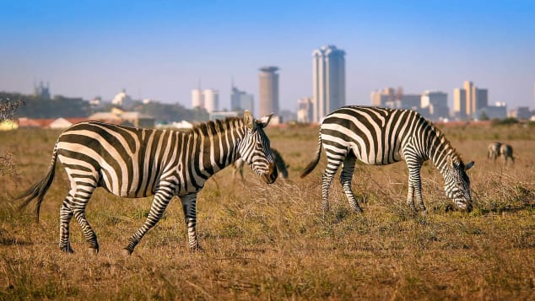


Slide 2
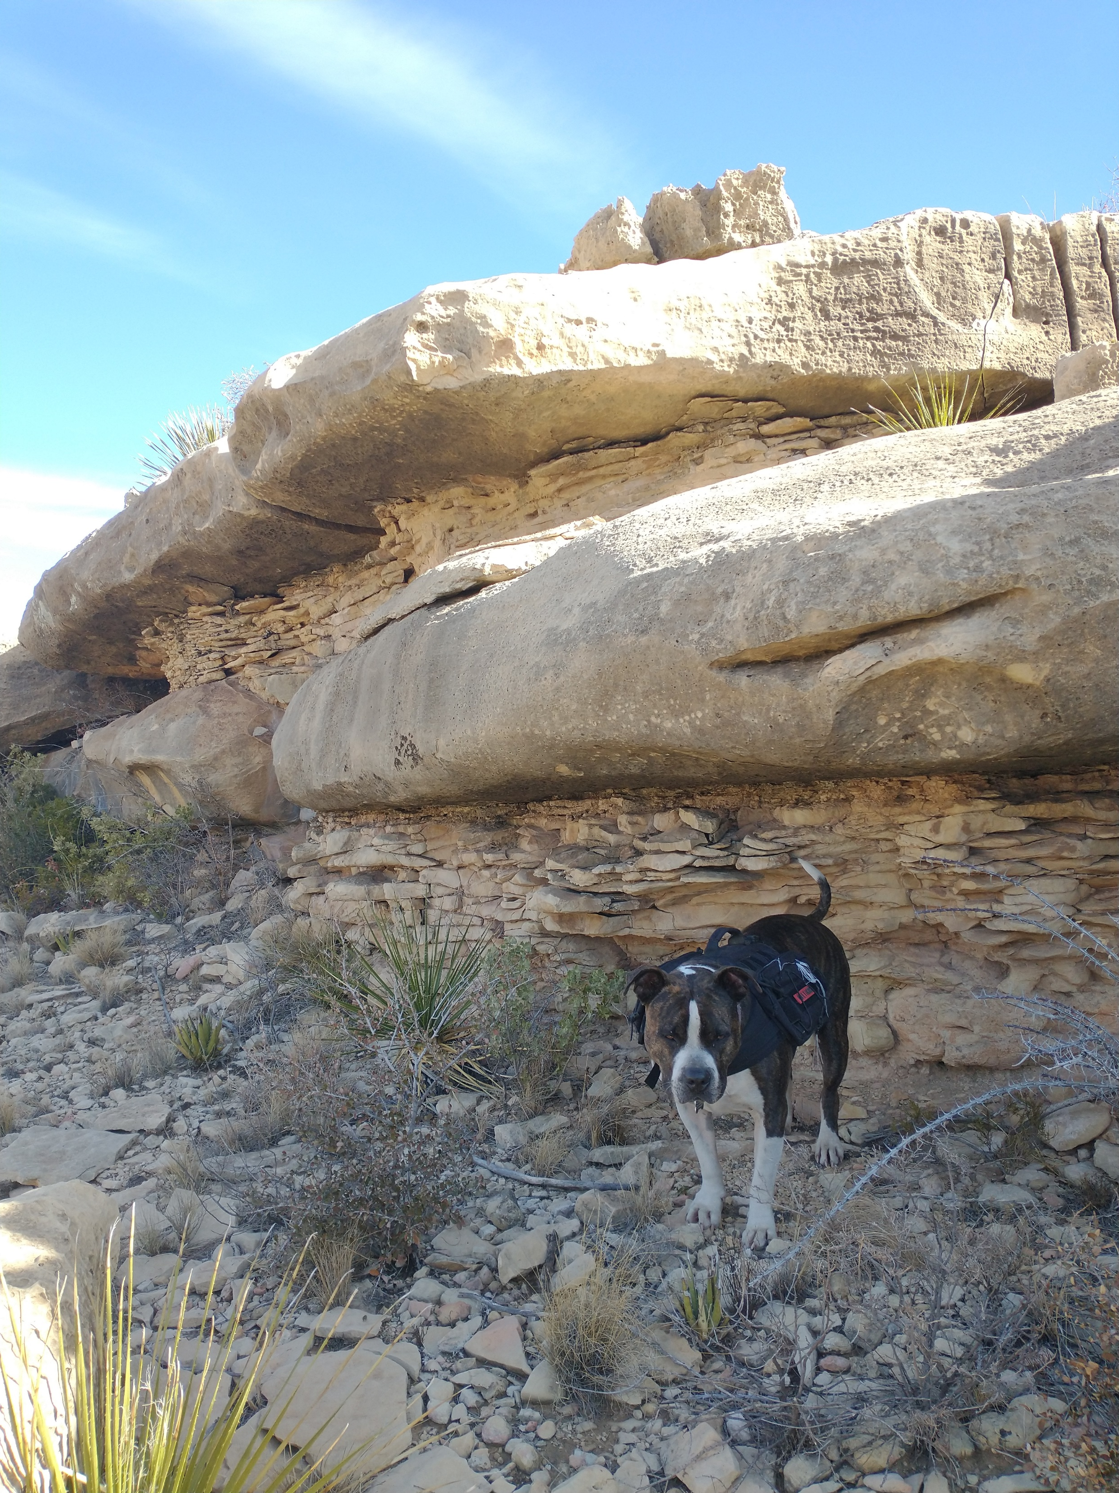
Notes:
There are also some really thinly bedded rock units in Last Chance canyon. Here is Remington posing in front of some carbonates which are laying on top of some very very thinly bedded sandstones. If I had to guess, I would imagine that these sandstones would not be able to hold a slope like the massive carbonate in the last slide.

Slide 3
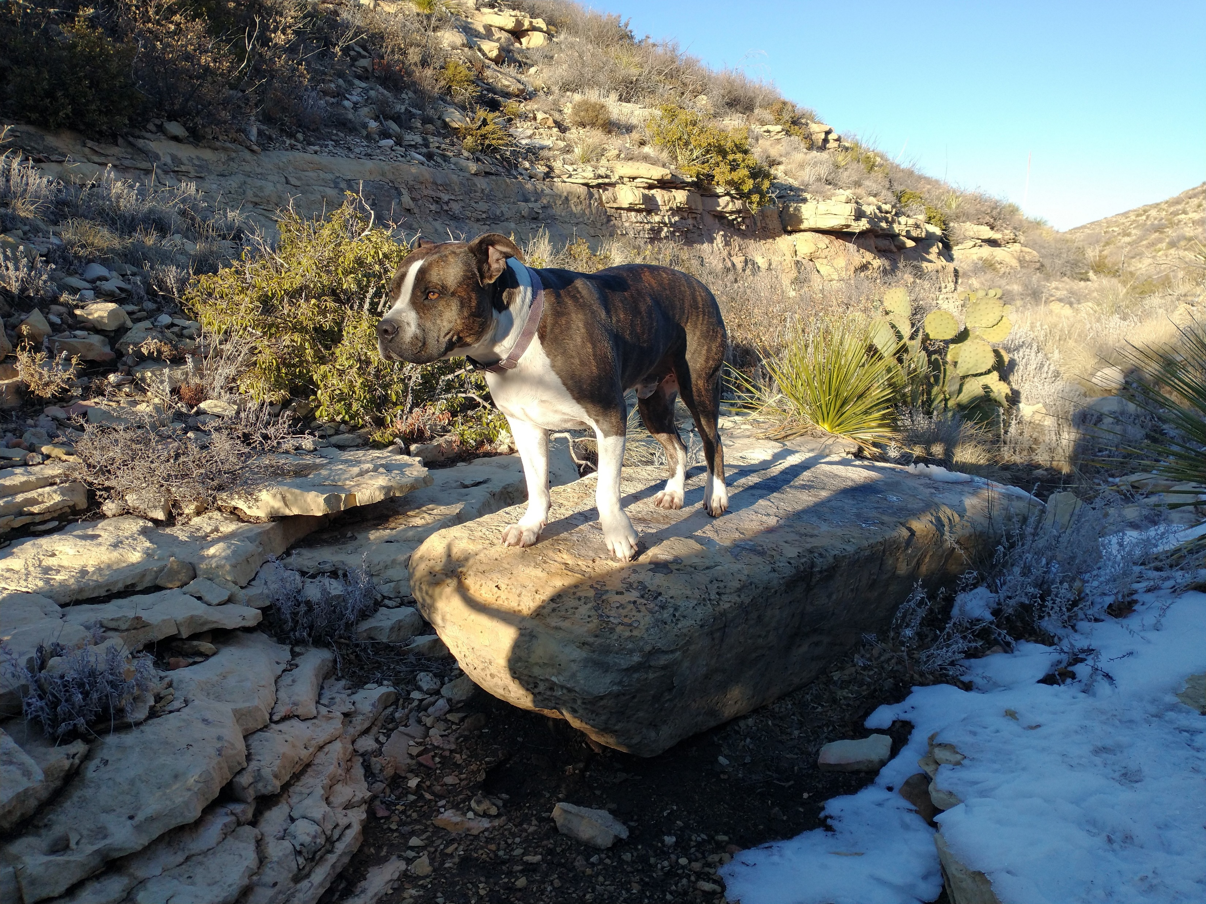
Shape factor = Dmin/Dmax
c
b
a
Notes:
Aside from collecting data regarding bedrock properties, I measured the largest boulder at every 40 ft elevation contour for the five different surveyed streams. I measured distance along three axis. The longest, the a axis, the second longest, the b axis and the shortest, the c axis. With this data I was able to calculate boulder volume, shape factor, and investigate how bed thickness affects the length of each of the three axis.

Slide 4
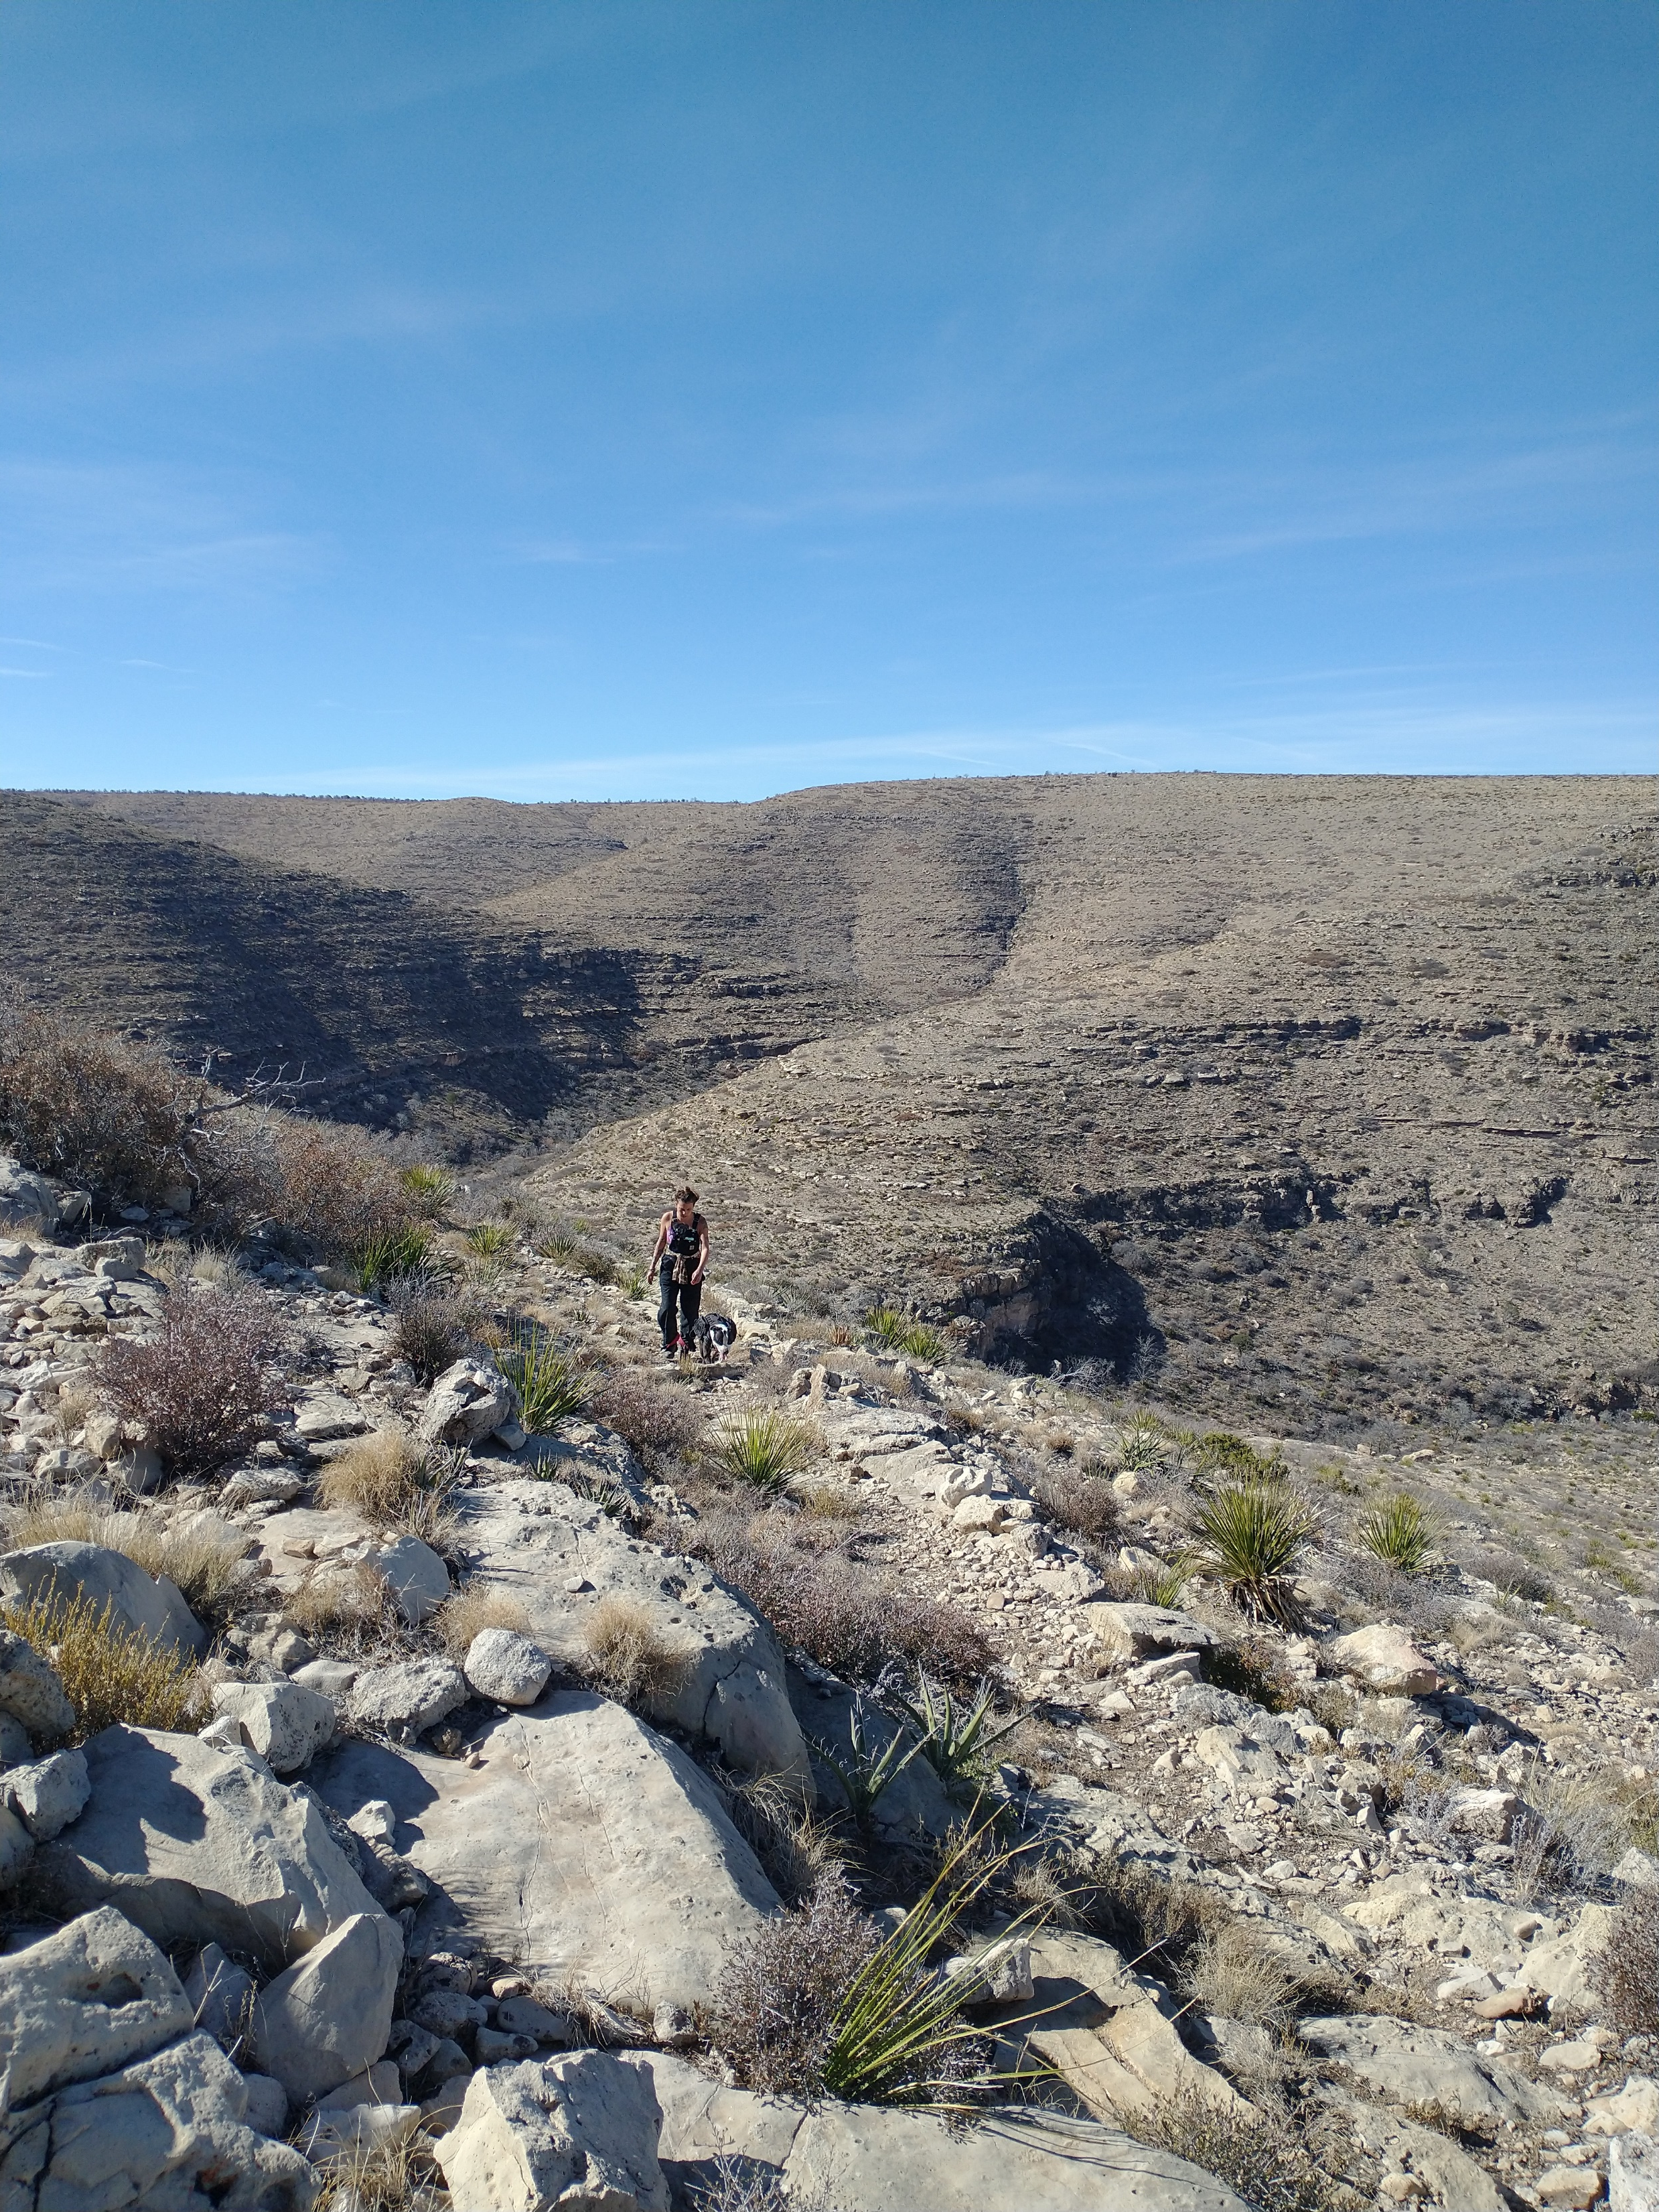
Notes:
…as are hillslopes. Making hiking quite difficult. These are from elevations above 1640m in LC1

Slide 5
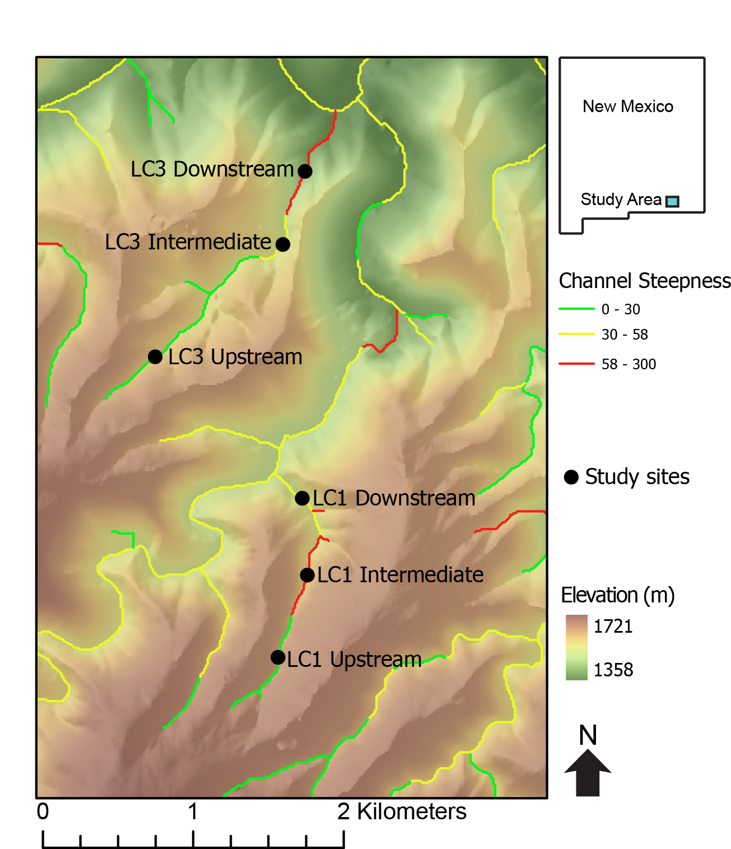
Other LC3 Upstream

Slide 6
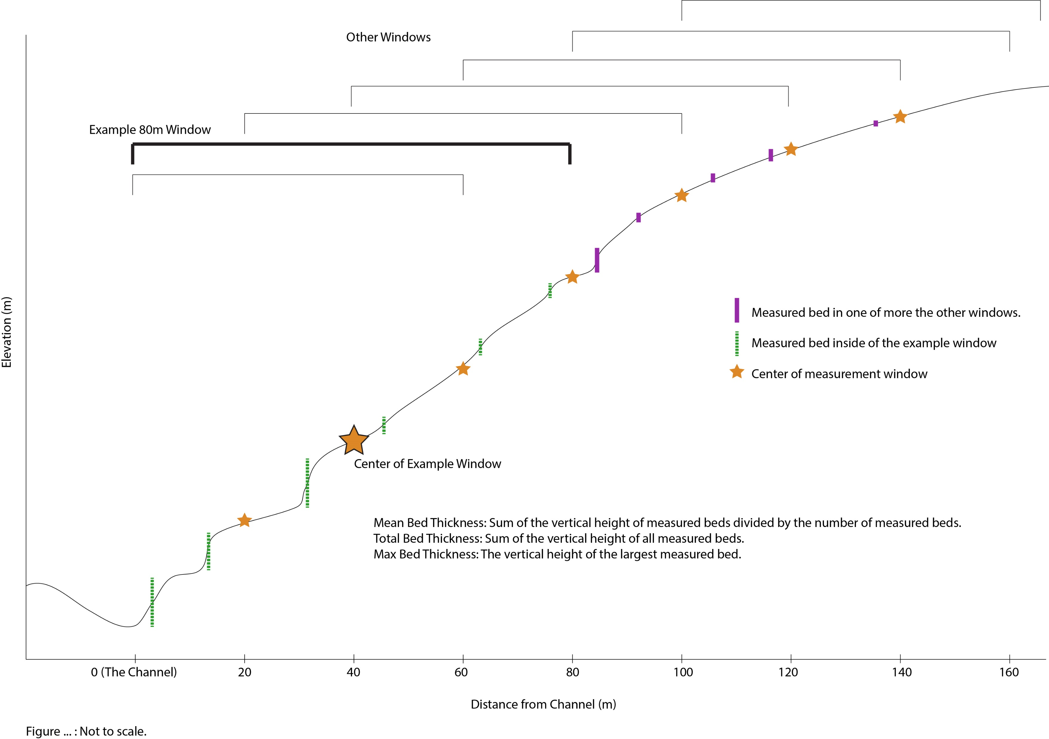

Slide 11
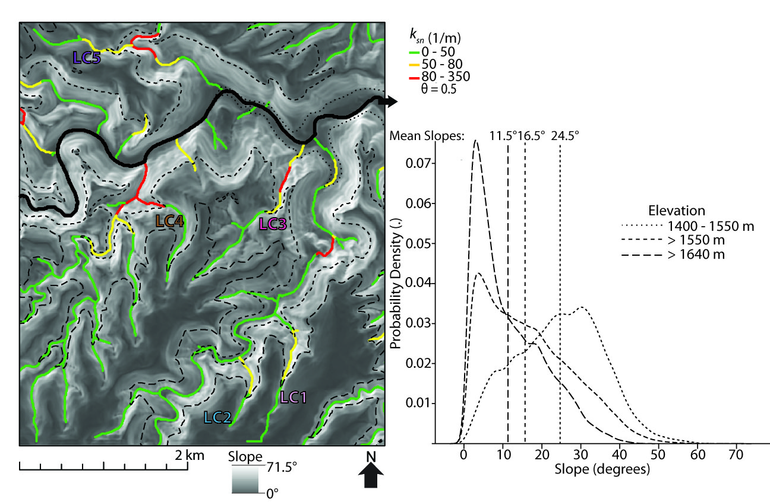

Slide 14
Other LC3 Upstream

Slide 17
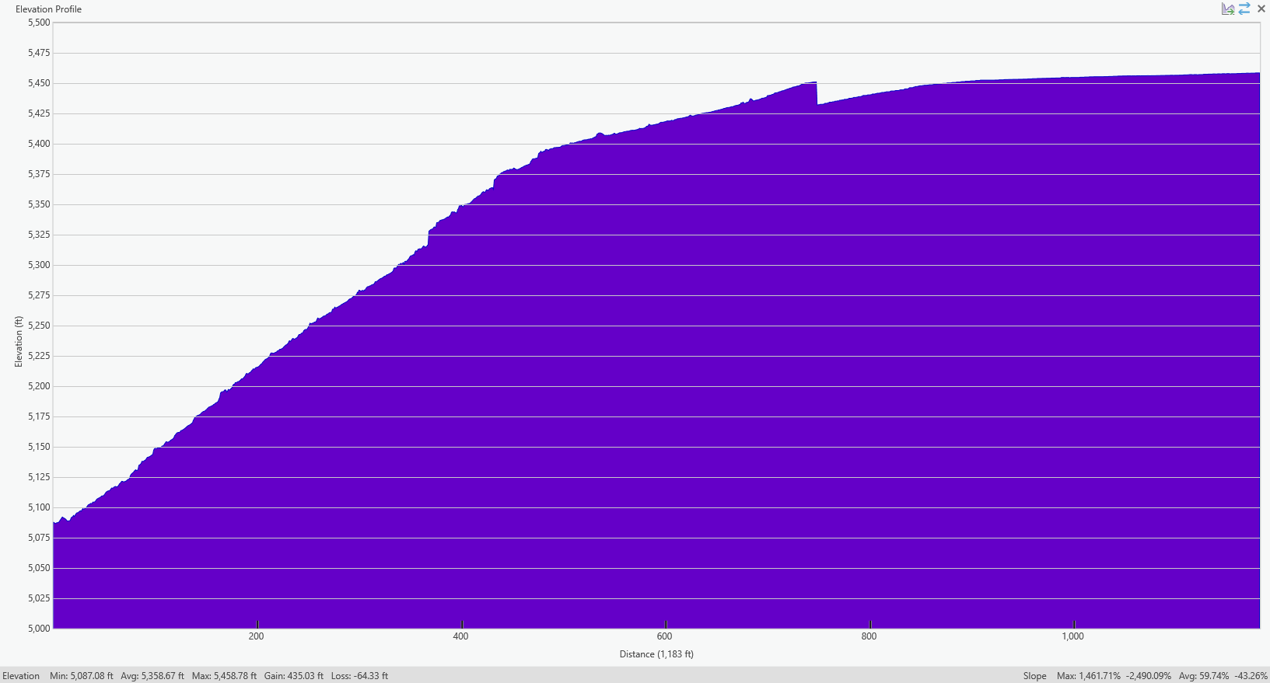

Slide 18
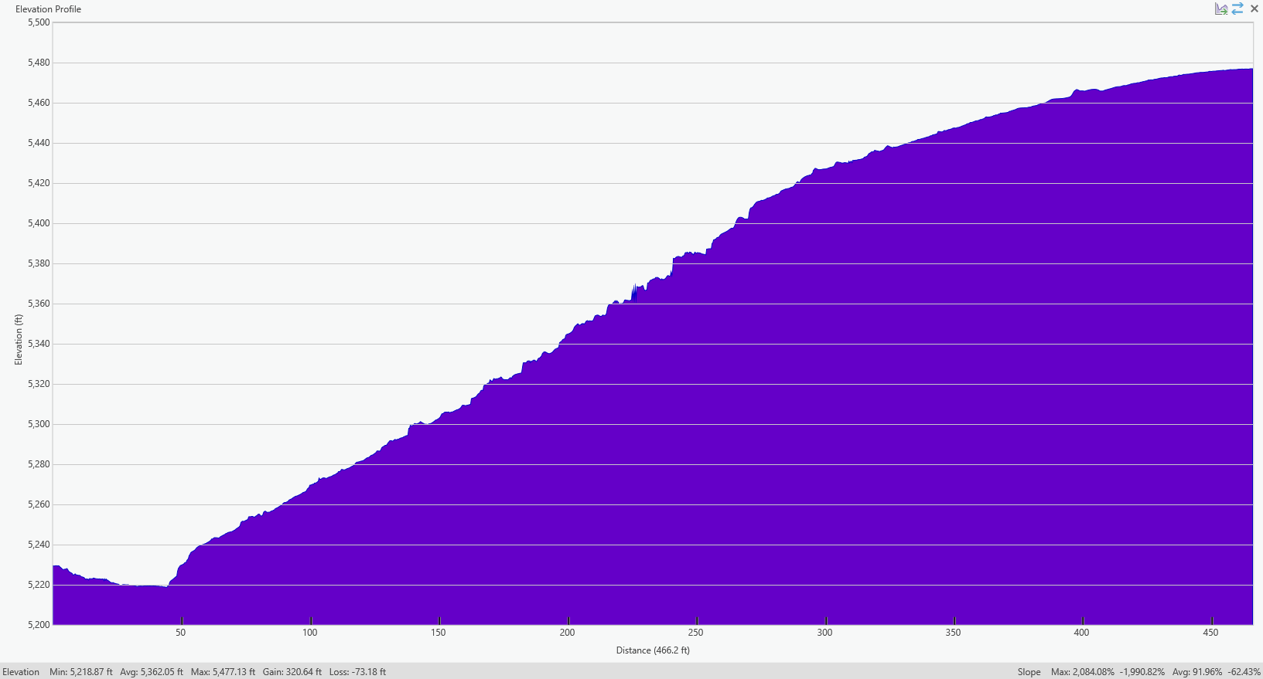
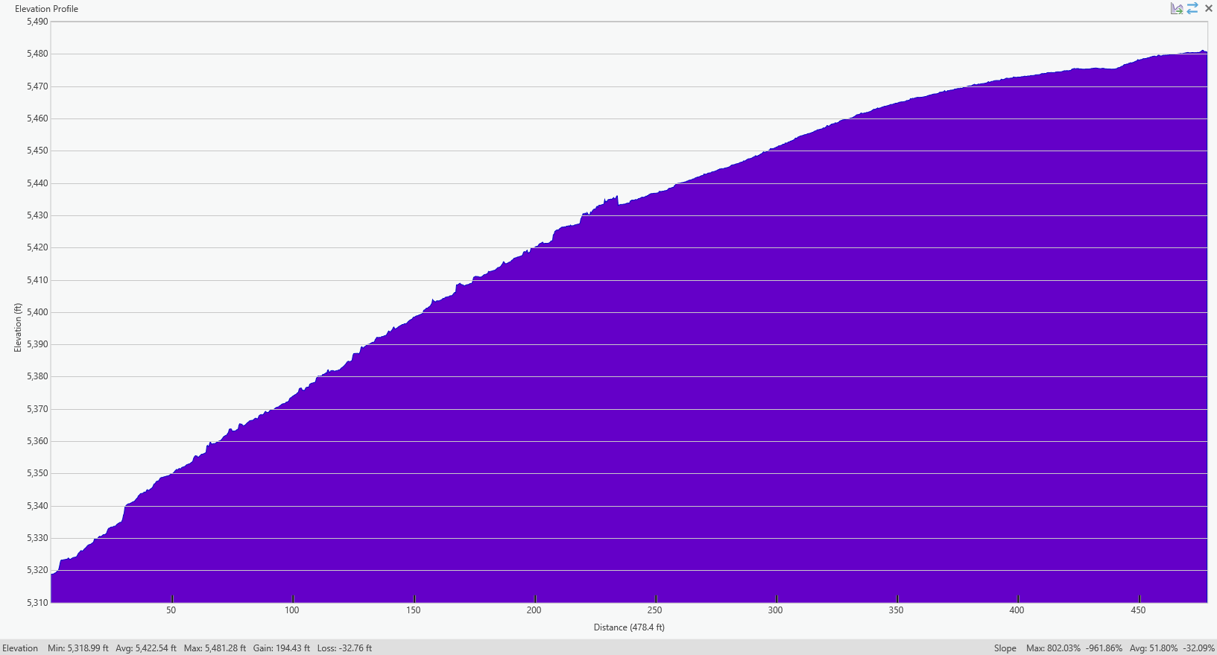

Slide 19
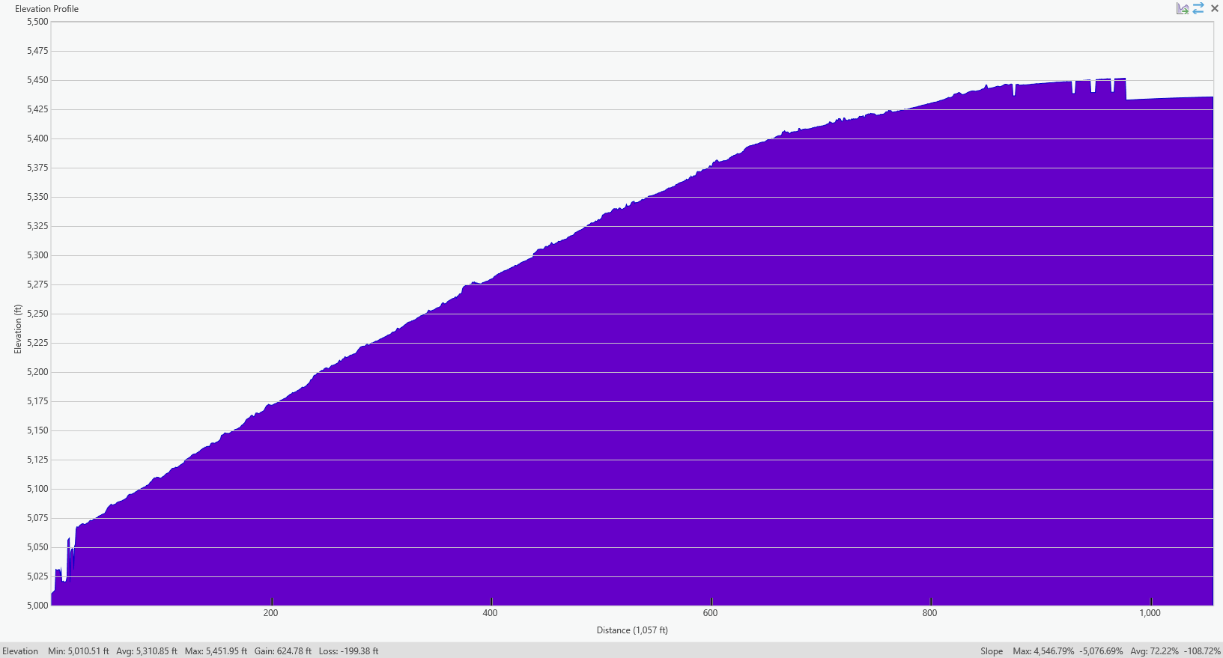

Slide 20
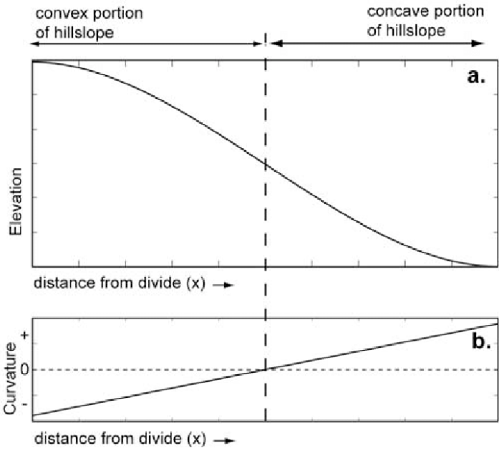
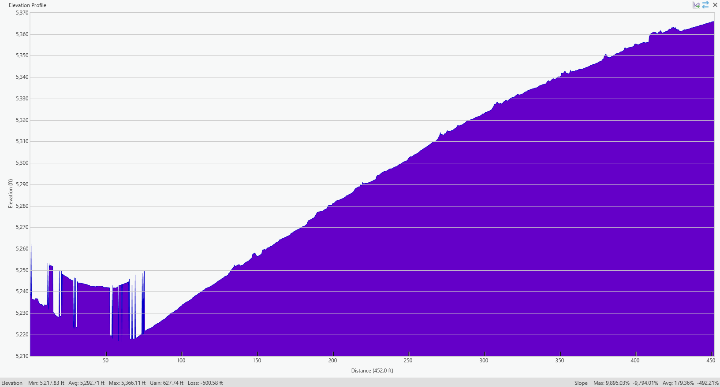
LC3 Shallow 1 is weird

Slide 22
Notes:
Have 3 of the 4 lowest standard deviations in bed thickness, mean bed thicknesses and max bed thickness. The other one is the other shallow transect in LC3. Leads me to believe that shorter beds that are more similar in size cause hillslopes to look “diffuse”.

Slide 23
The plots in the former slide have 3 of the 4 lowest values for standard deviation of bed thickness, mean bed thicknesses and max bed thickness. The other one is the other shallow transect in LC3 (shown below). Leads me to believe that shorter beds that are more similar in size cause hillslopes to look “diffuse”.

Slide 24
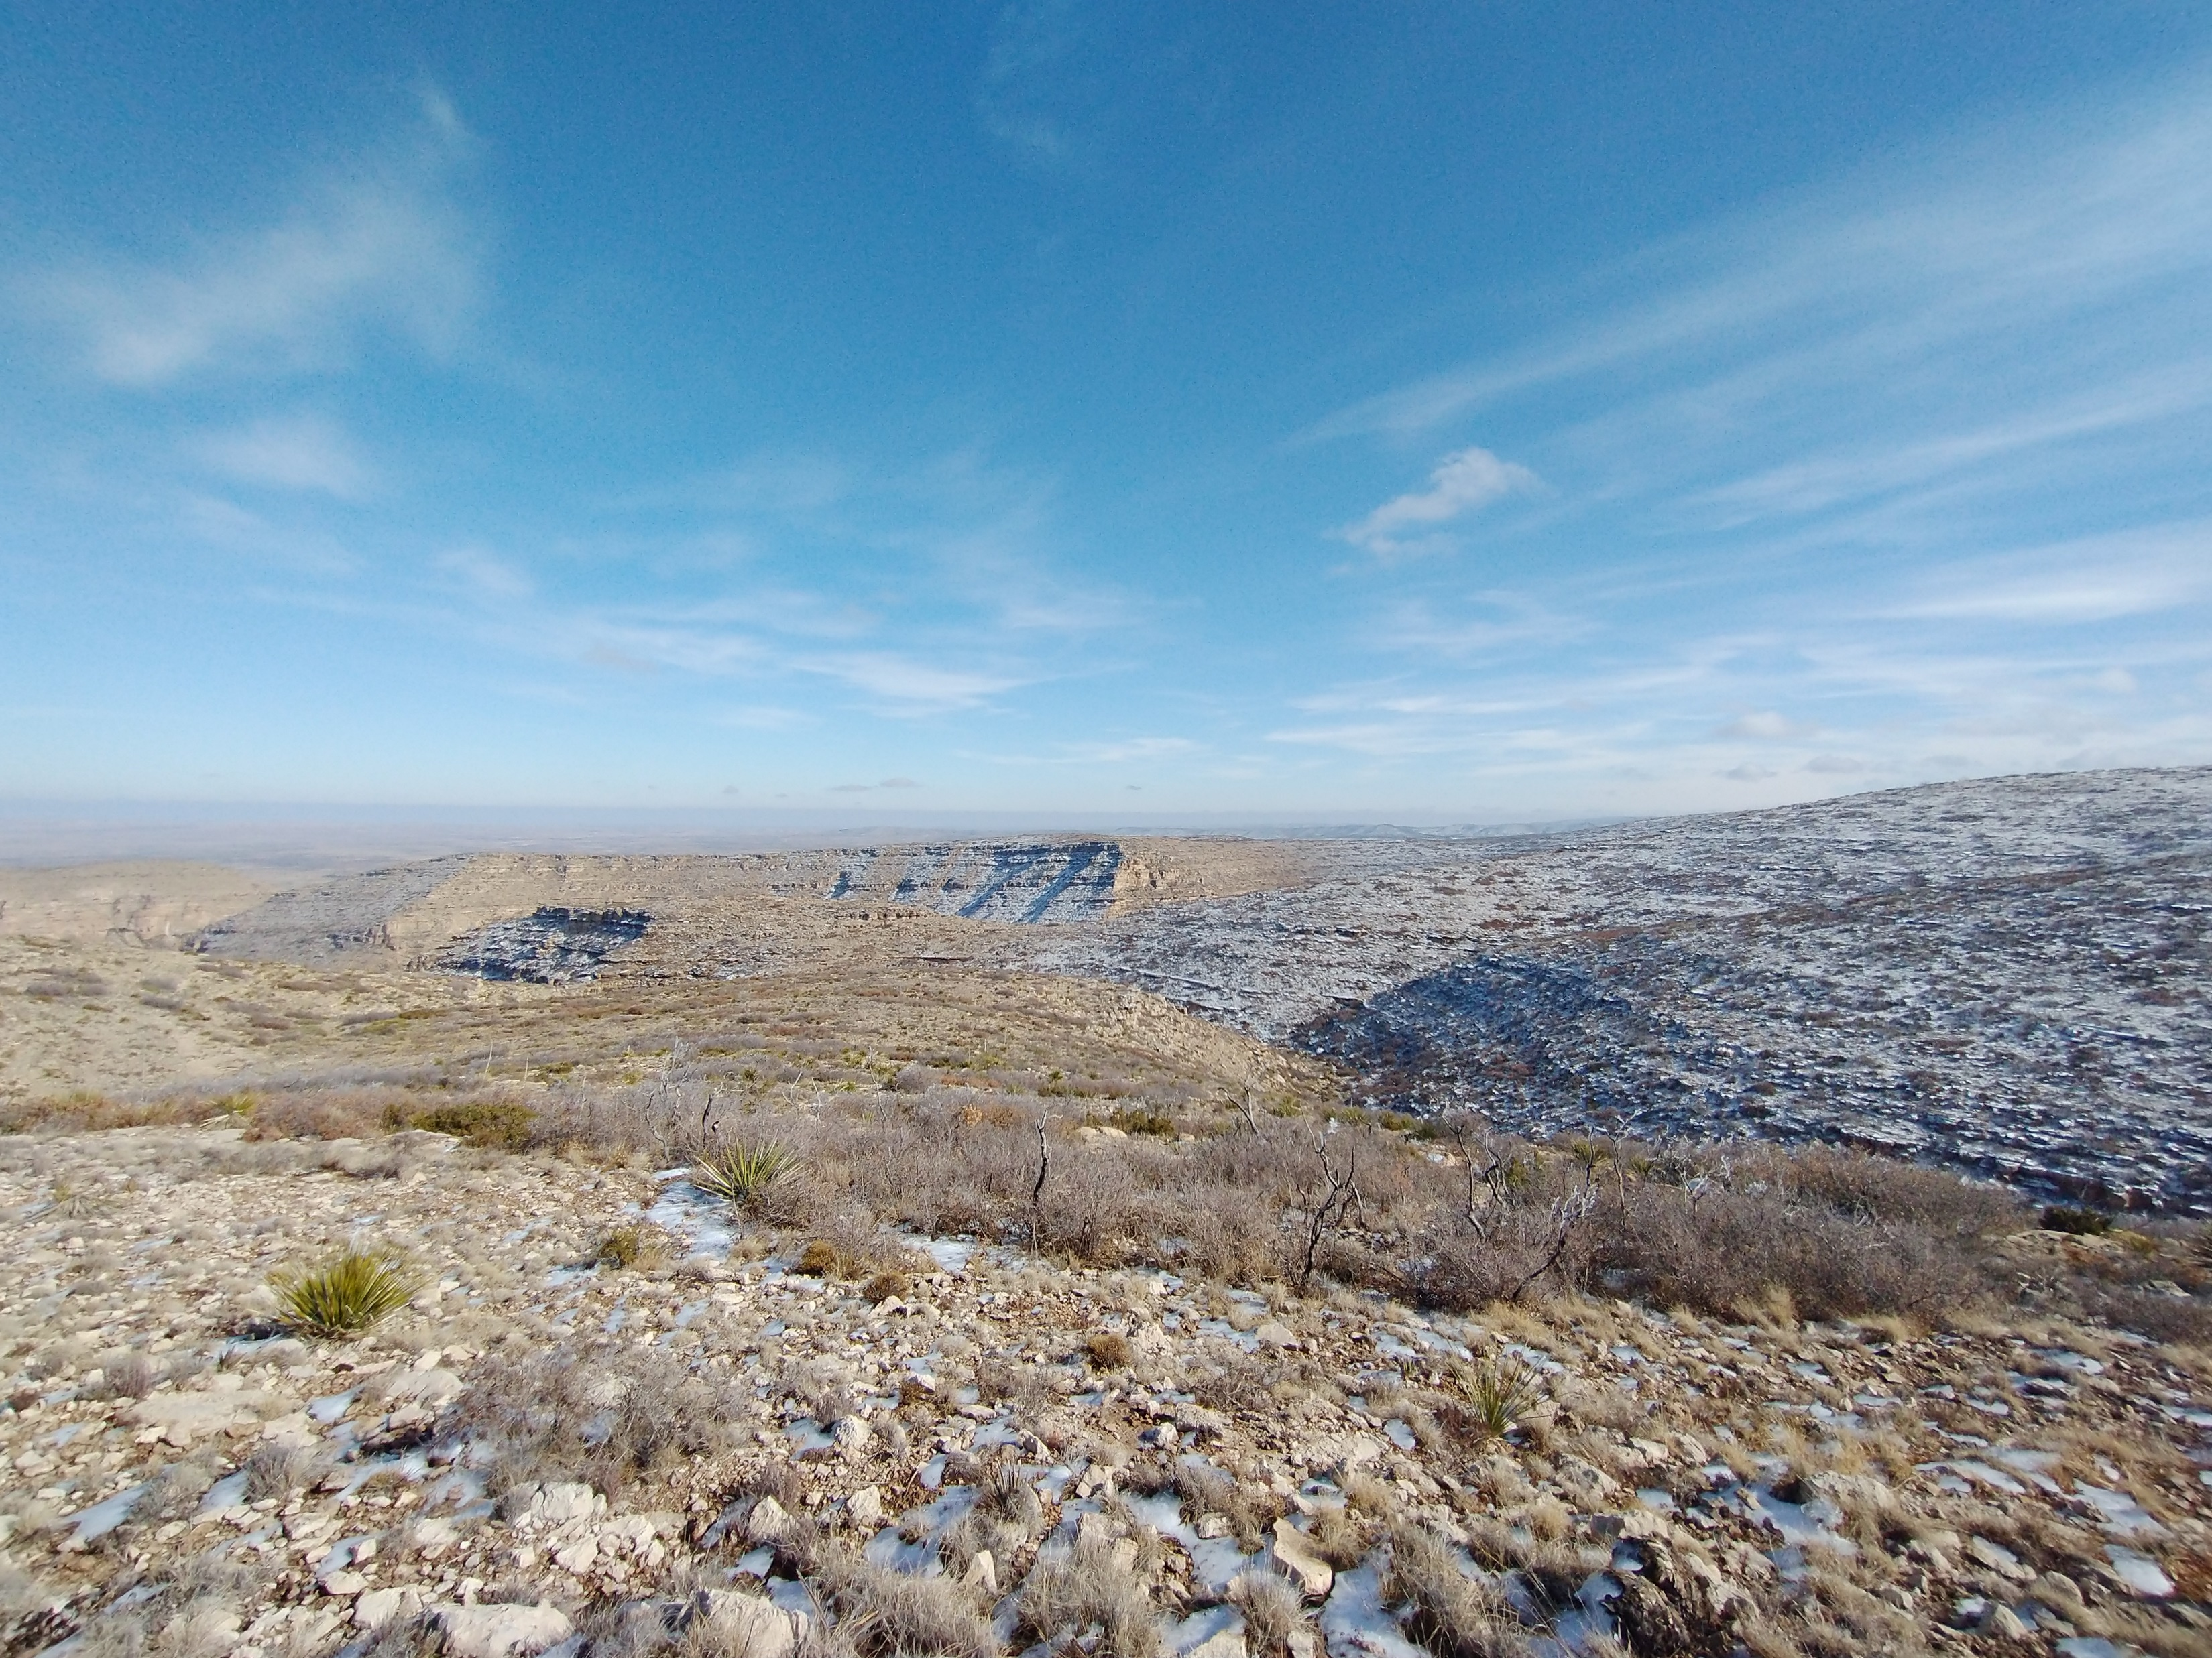
Notes:
These higher elevation, upstream channel sections also have lower gradient hillslopes like these very mellow and chill hills. Again, this reflects the data I presented in the density plot a few slides ago.

Slide 26
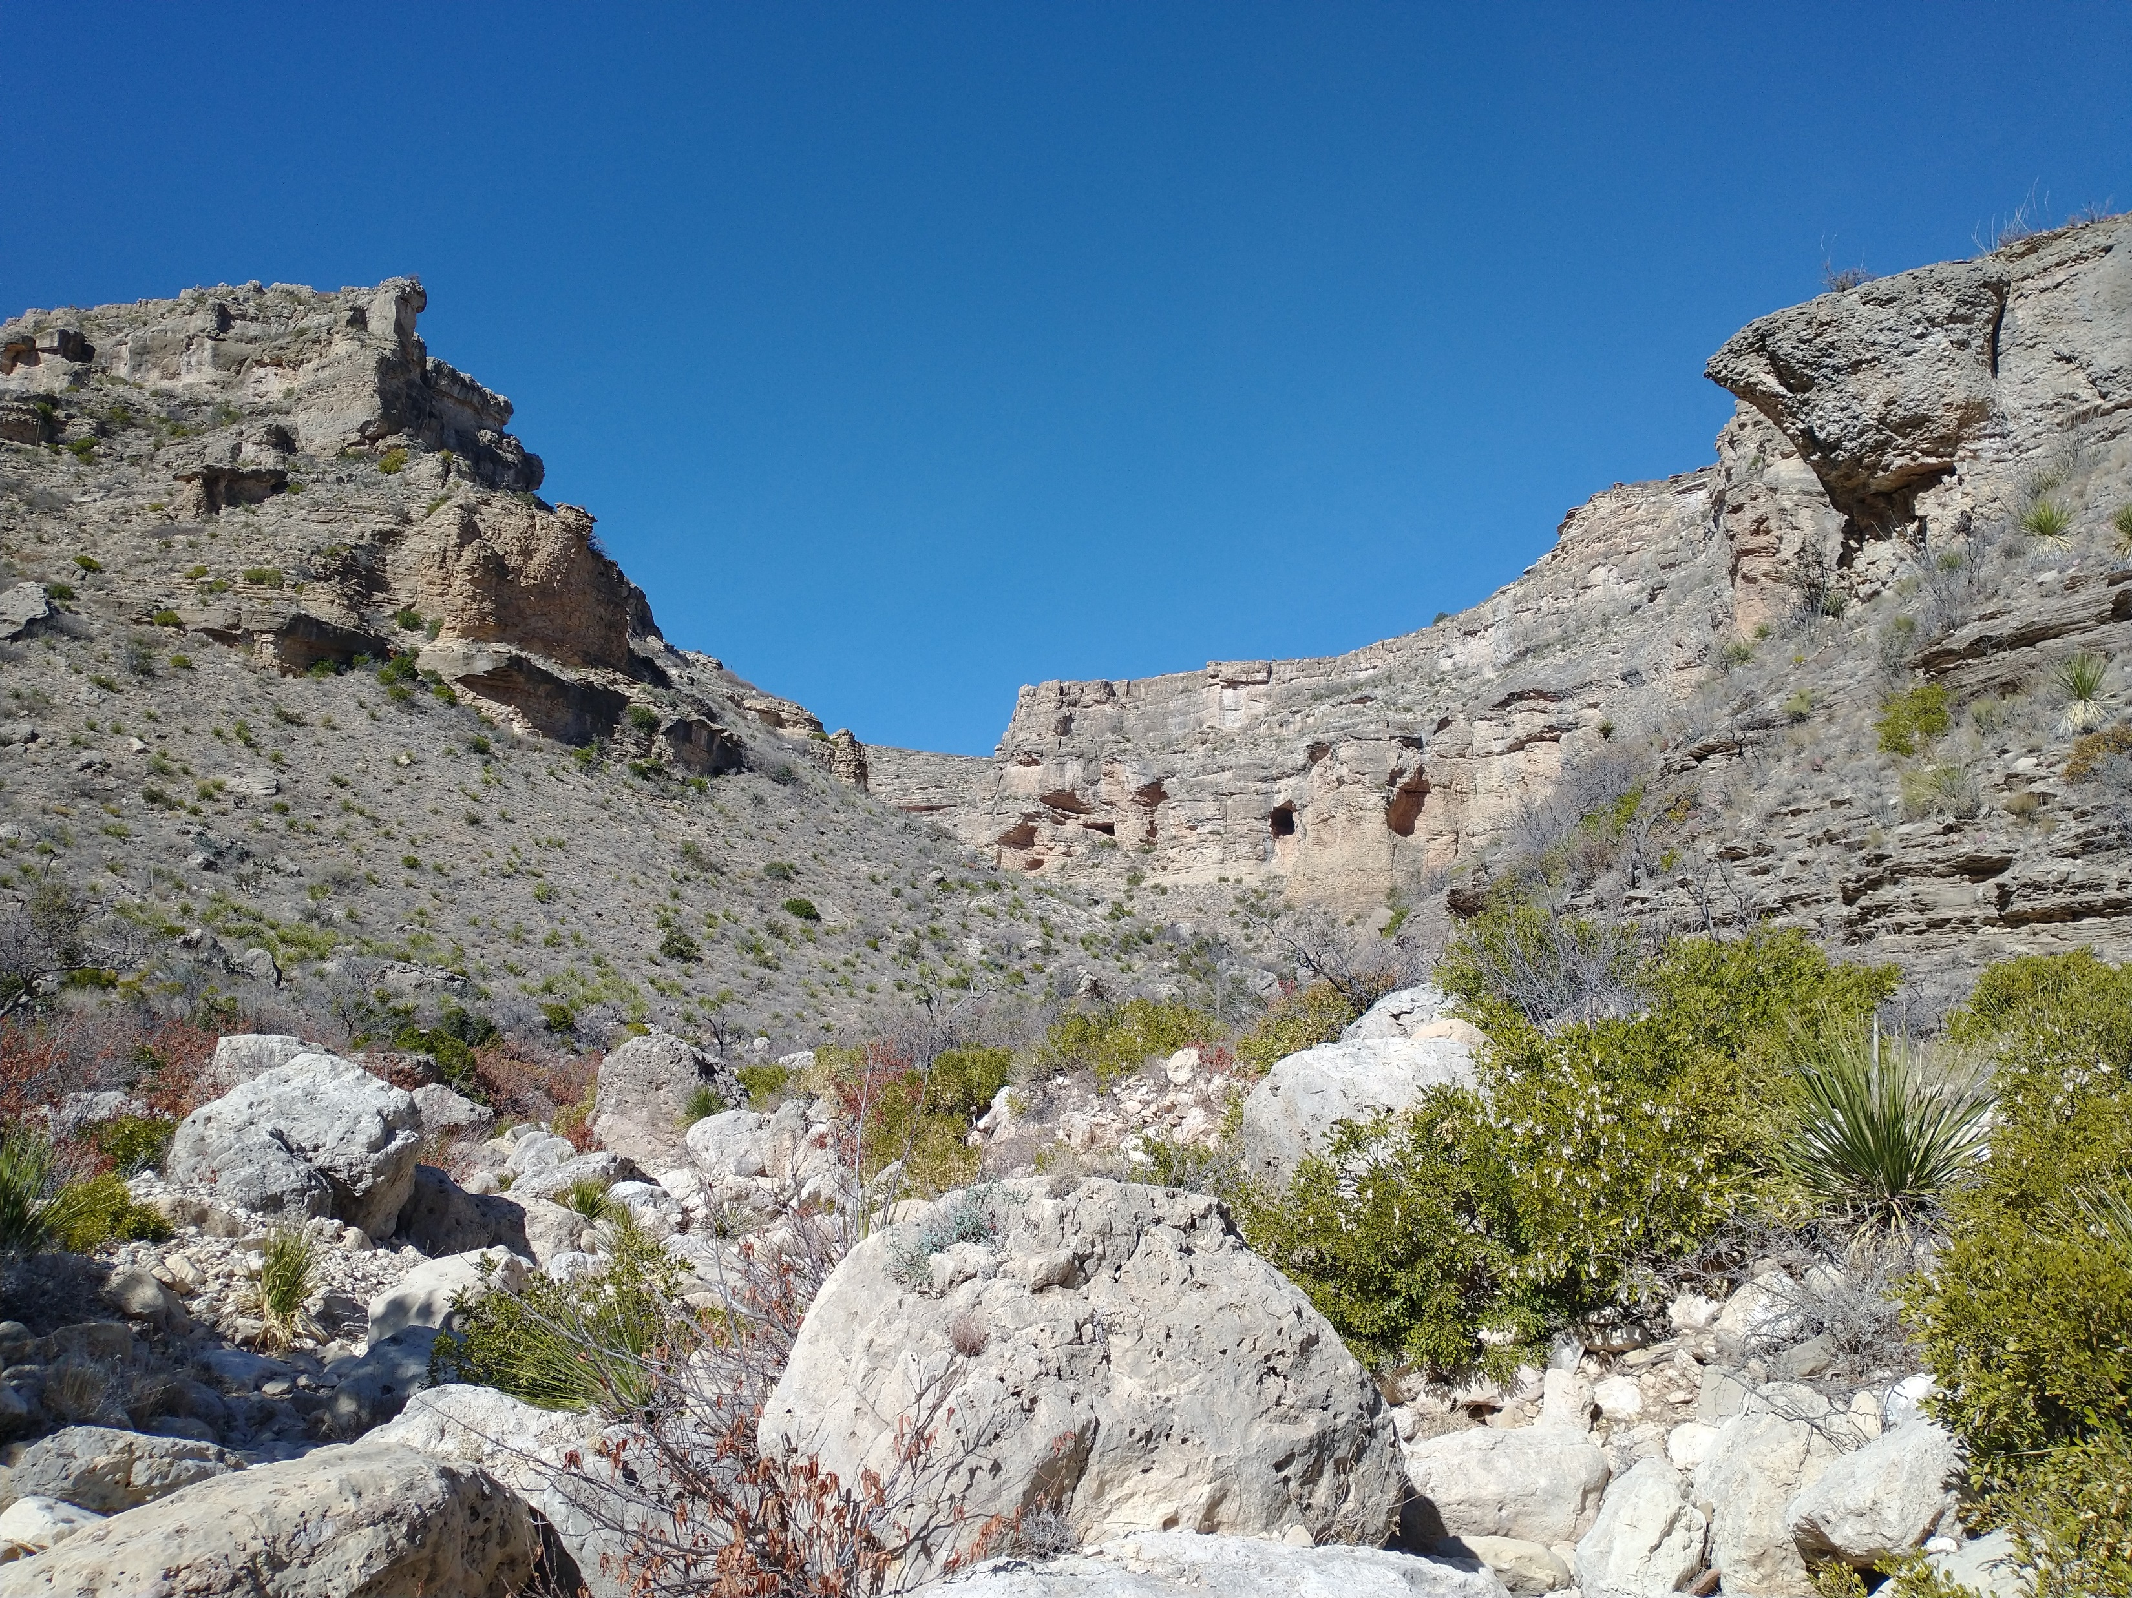
Notes:
Conversely, at elevations between 1400m and 1550m, in LC5, channels are quite steep

Slide 27
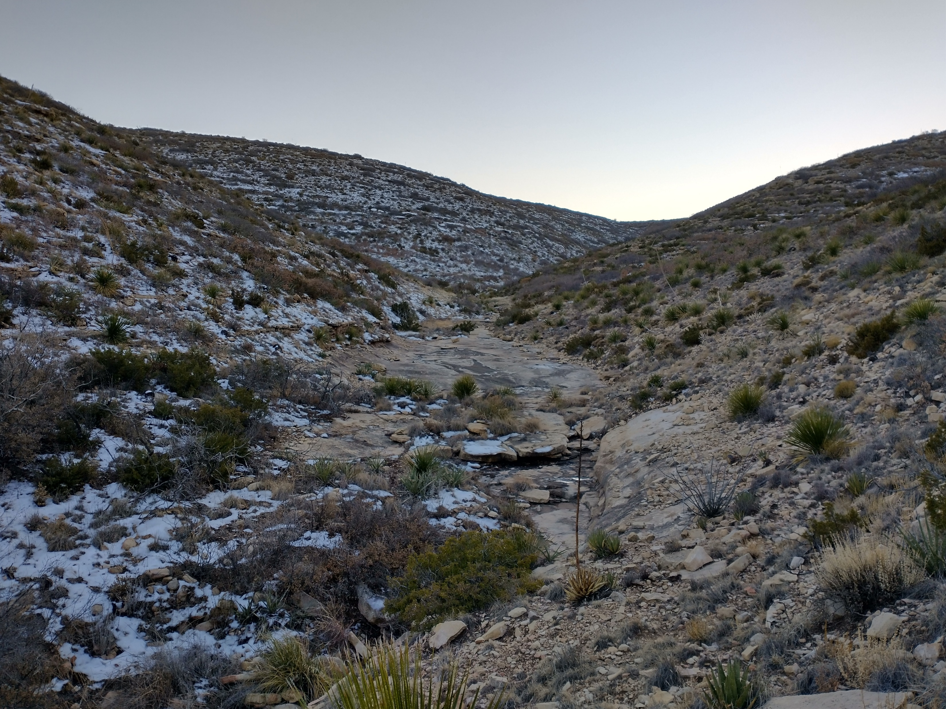
How Often Do Storm Events Transport Sediment and Where Does Sediment get Transported To?
Notes:
And what we saw in the field is reflective of our DEM analysis. Above 1550m, in LC3, channel sections like this, generally have low slopes. They are very hikeable.

Slide 29
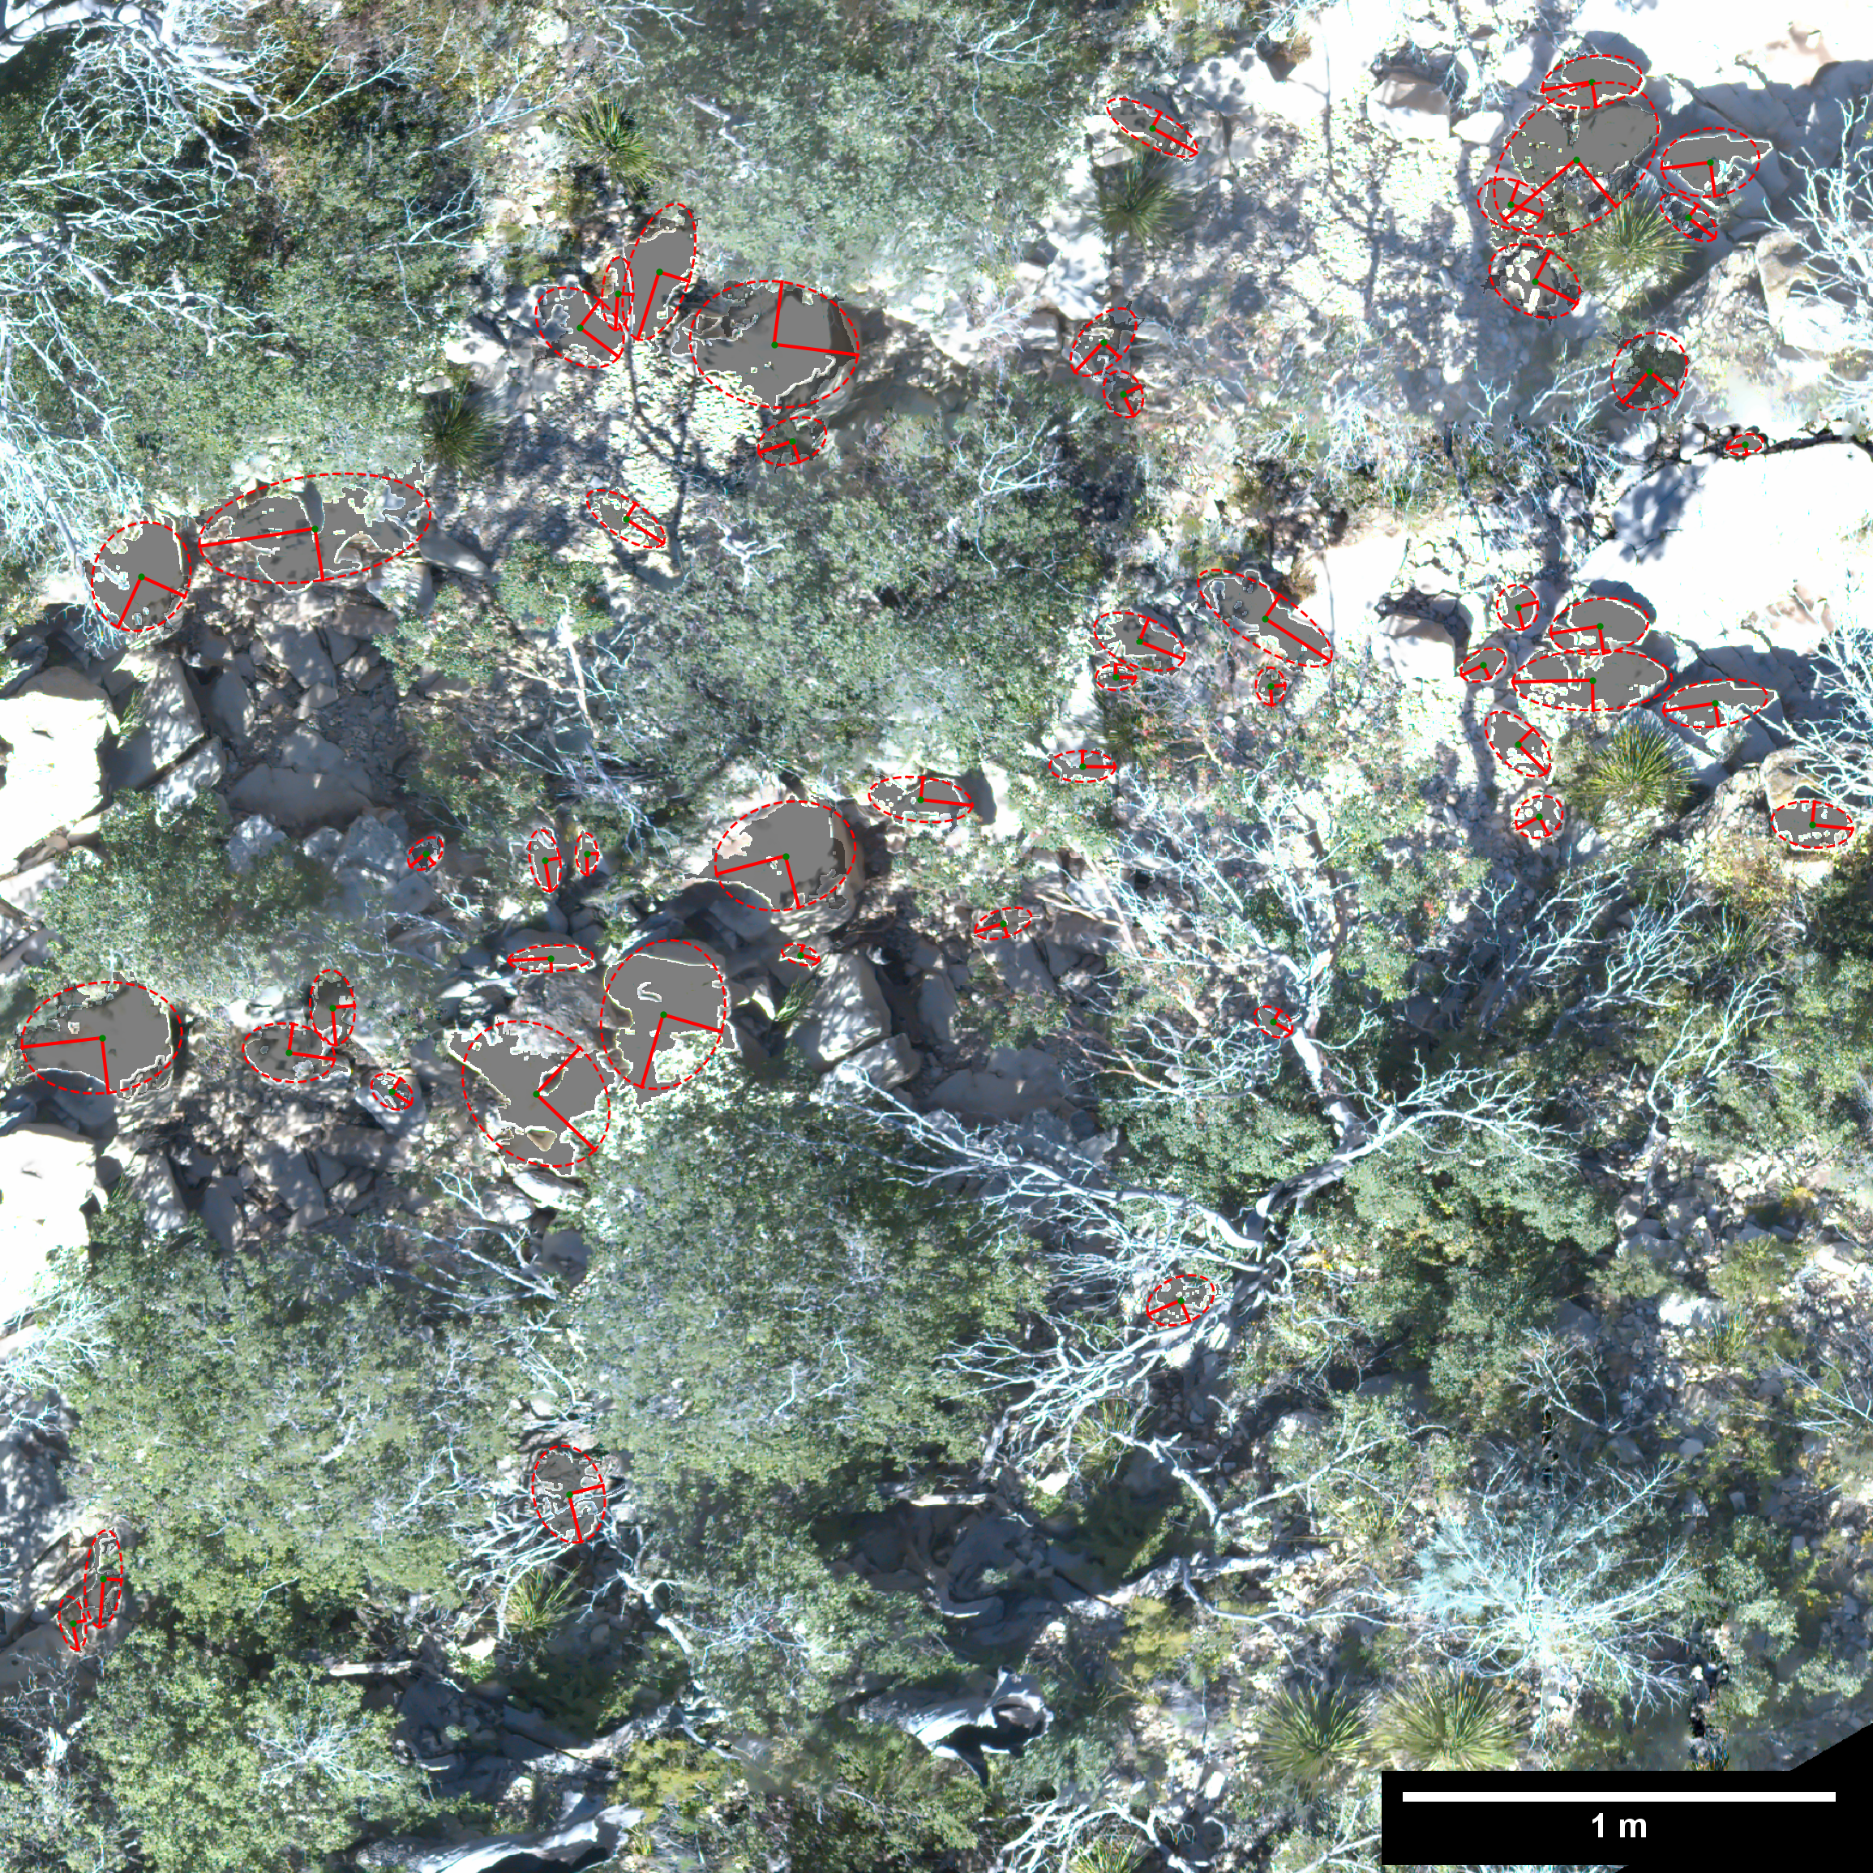

Slide 33
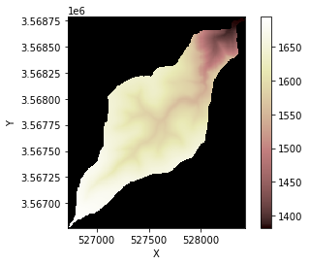
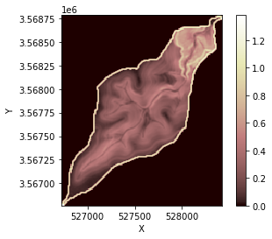

Slide 34
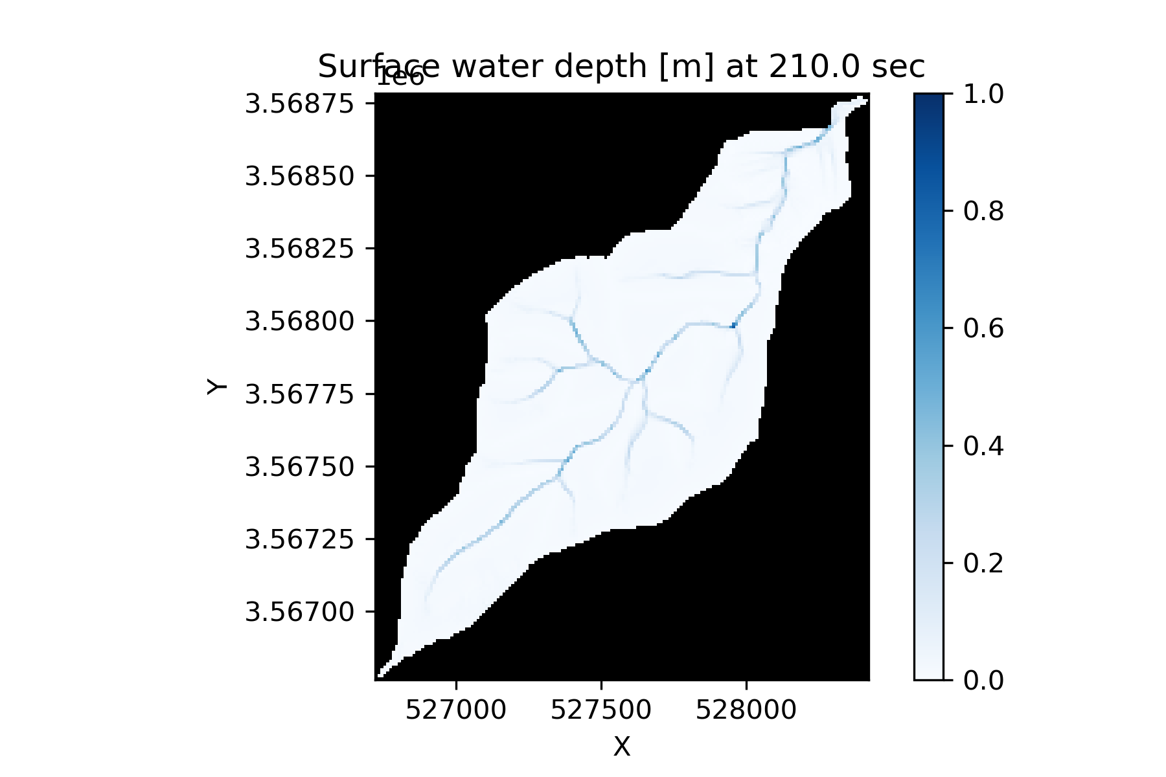




Slide 35
